Slide 1
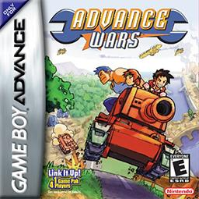
AWAI Advance Wars Artificial Intelligence
Project and Presentation by:
Michael Urciuoli

Slide 2
AWAI
Agenda
Advance Wars Background
Project Description
Program Architecture
Results
Future Works
Questions

Slide 3
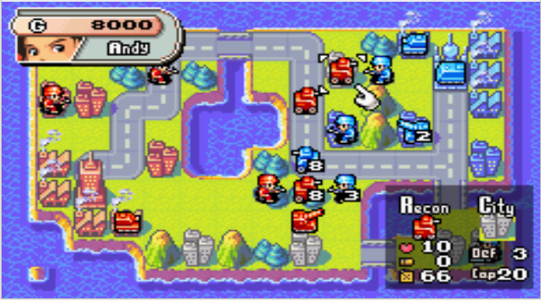
AWAI
Advance Wars Background
Turn-based RTS
Two or more armies
2D grid game map
Terrain effects units attack and movement
Money used to create units
Either capture the opposing HQ or eliminate their units

Slide 4
AWAI
Project Description
The purpose of this project was to create an Artificial Intelligence that can play the game Advance Wars. In order to asses the AI’s performance, it plays against the games native AI.

Slide 5
AWAI
Program Architecture
SCAN
Read terrain and unit data from map
Build internal representation of game state
MOVE
Choose best move based on Benefit-Cost formula
Evaluate move, then repeat for other units
BUILD
Spend as much money as possible
LOOP

Slide 6
AWAI
Program Architecture
SCAN
Read turn, money, and each unit/terrain at each grid square
Read by key points image matching
Store all info in an internal representation for use later

Slide 7
AWAI
Program Architecture
MOVE
Generate all possible moves, then score each move
Make the best move
Evaluate the outcome of that move
Regenerate moves based on new game state
Repeat until all units have moved
Notes:
Score factors include potential outcome of attacks (including overkill) terrain advantage, distance from the enemy HQ or other objectives, amount of fuel consumed, and starting unit health. Infantry units also consider capturing territories above all else.
Move evaluation includes reading the new health of both attacking and defending units (if an attack), ensuring that the unit actually moved to its desired location (or if it ran into a hidden unit), and checking the area around a unit (for more hidden units).

Slide 8
AWAI
Program Architecture
BUILD
Create a wish list of units, currently based on cost
More money = better
Ignore specialized units unless certain circumstances exist
Attempt to build each unit on wish list based on available bases
Notes:
Score factors include potential outcome of attacks (including overkill) terrain advantage, distance from the enemy HQ or other objectives, amount of fuel consumed, and starting unit health. Infantry units also consider capturing territories above all else.
Move evaluation includes reading the new health of both attacking and defending units (if an attack), ensuring that the unit actually moved to its desired location (or if it ran into a hidden unit), and checking the area around a unit (for more hidden units).

Slide 9
AWAI
Results
BEST CASE?
(my AI is the red force)

Slide 10
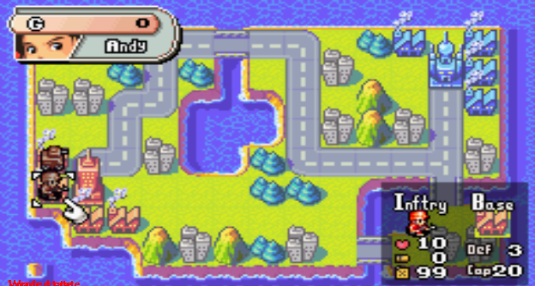
AWAI
Results

Slide 11
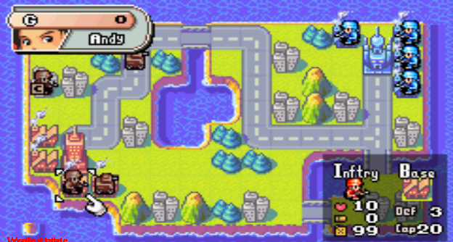
AWAI
Results

Slide 12
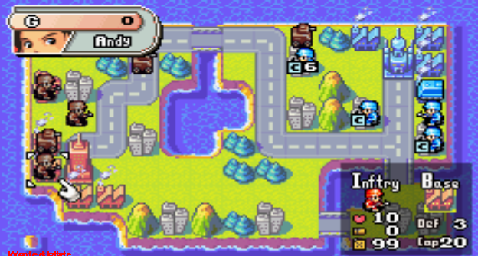
AWAI
Results

Slide 13
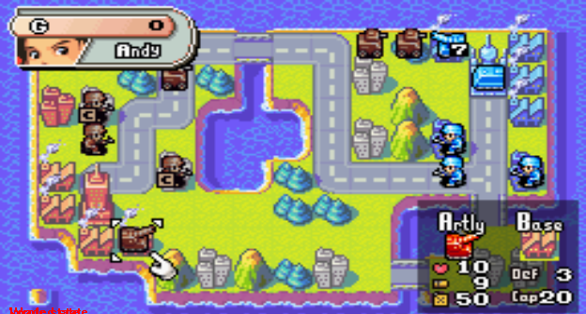
AWAI
Results

Slide 14
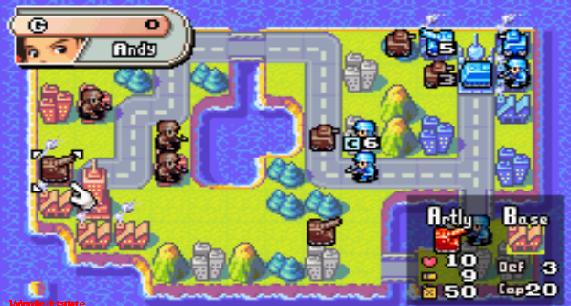
AWAI
Results

Slide 15
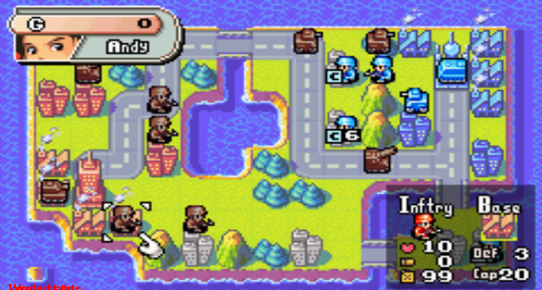
AWAI
Results

Slide 16
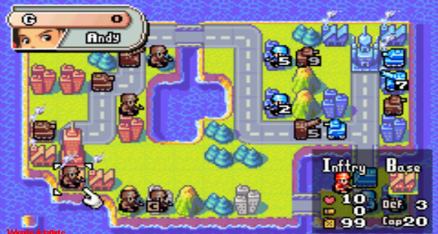
AWAI
Results

Slide 17
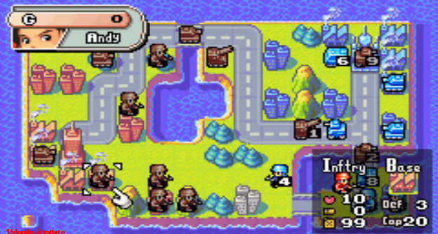
AWAI
Results

Slide 18
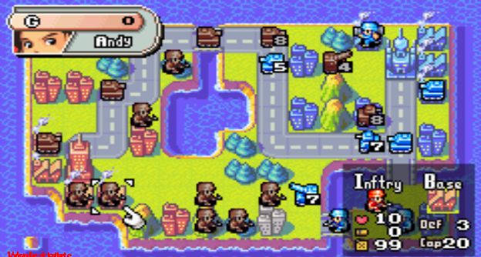
AWAI
Results

Slide 19
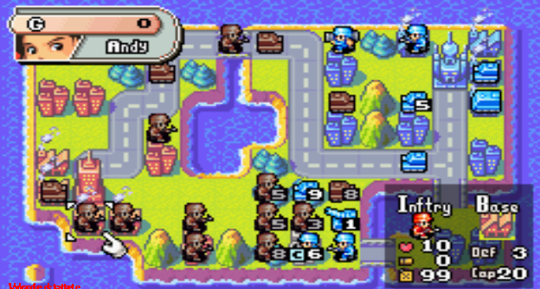
AWAI
Results

Slide 20
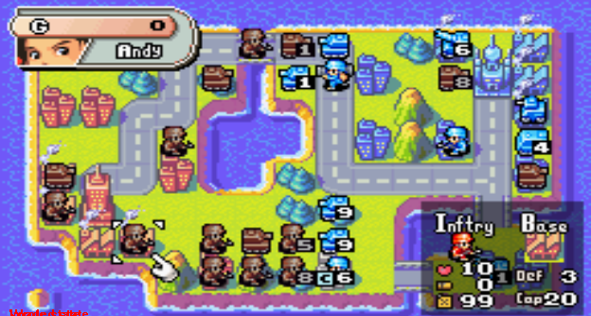
AWAI
Results

Slide 21
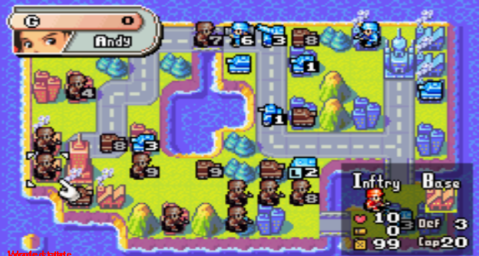
AWAI
Results

Slide 22
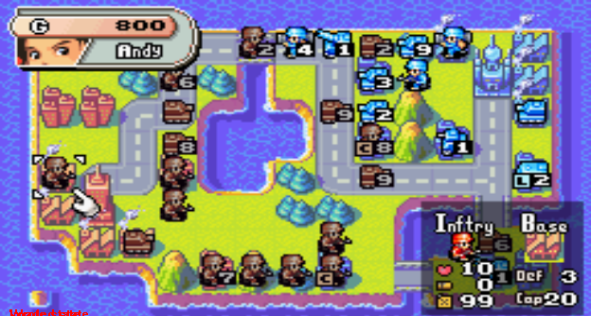
AWAI
Results

Slide 23
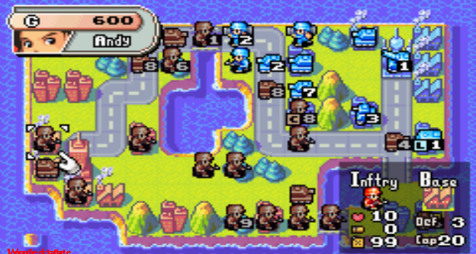
AWAI
Results

Slide 24
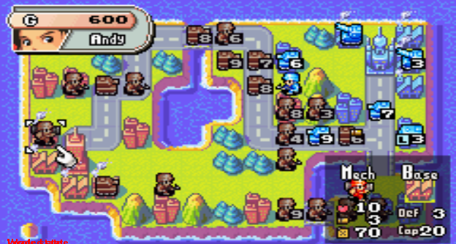
AWAI
Results

Slide 25
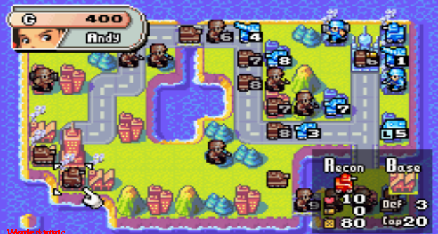
AWAI
Results

Slide 26
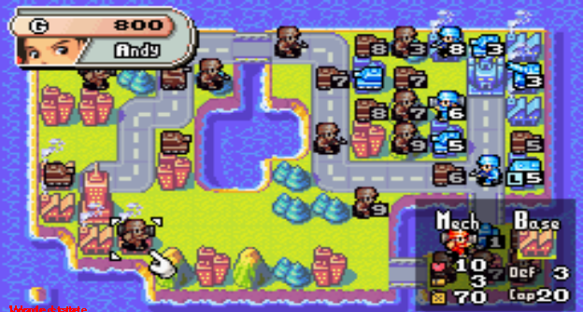
AWAI
Results

Slide 27
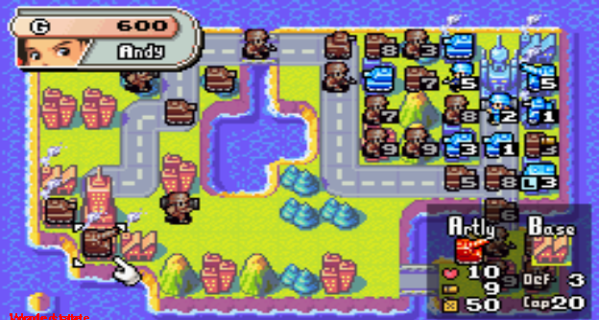
AWAI
Results

Slide 28
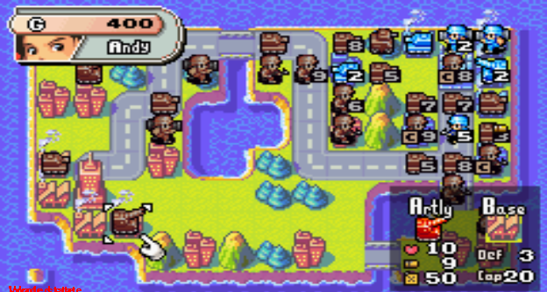
AWAI
Results

Slide 29
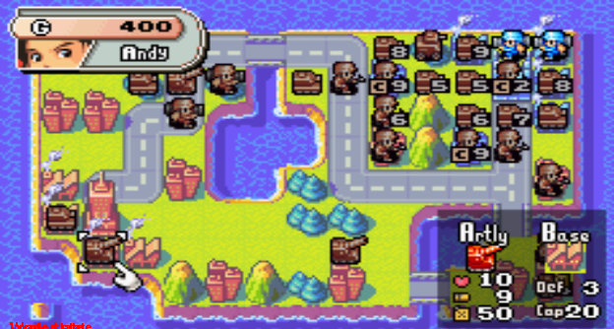
AWAI
Results

Slide 30
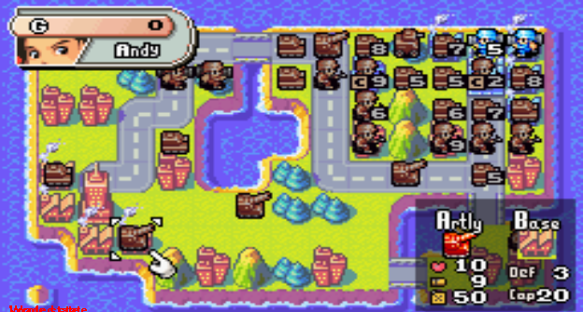
AWAI
Results

Slide 31
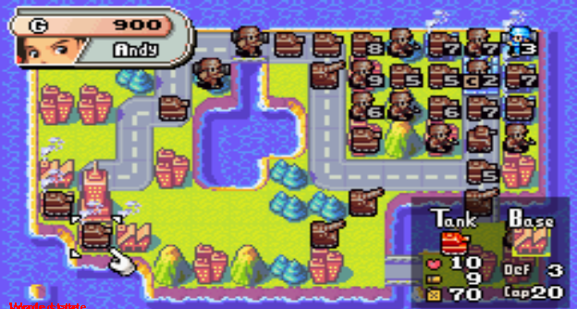
AWAI
Results

Slide 32

AWAI
Results

Slide 33
AWAI
Results
Not so good case…

Slide 34
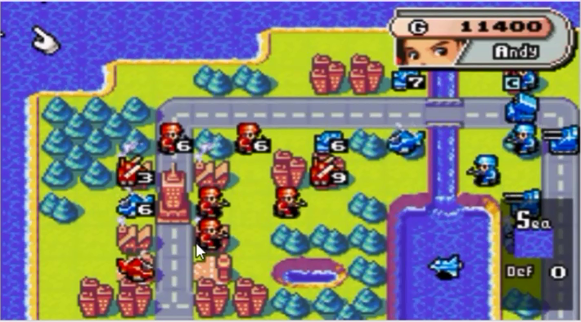
AWAI
Results
(The map extends to the right, with a lot of enemy forces. Things are not looking good for the red team…)

Slide 35
AWAI
Results
Main points to consider
Scanner does its job, but could be faster
Movement formula works well during:
Small maps
Force-on-force battles (can’t build more units)
Fails in larger maps
Building units is done very shortsightedly

Slide 36
AWAI
Future Works
Planning
Move in relation to a goal
Changing sub-plans
Build units based on predicted needs
Meta Map
Parallel to game state, but simplified version of the map
Lowers the branching factor of the game state
less possibilities = simpler design and faster performance

Slide 37
AWAI
Questions
?

